Slide 1



Medical physics first year
L19- Physics Of Eyes And Vision
Defective Vision and Its Correction
By Assistants professor
Dr. Mohammed Ali Jaber
Physiology Department
College of Medicine
University of Basrah

Slide 2
Defective Vision and Its Correction
Learning Objectives
By the end of this section, you will be able to learning about:
Defective Vision and Its Correction
Hypermetropia or long-sight
Astigmatism and its correction
Presbyopia and its correction

Slide 3
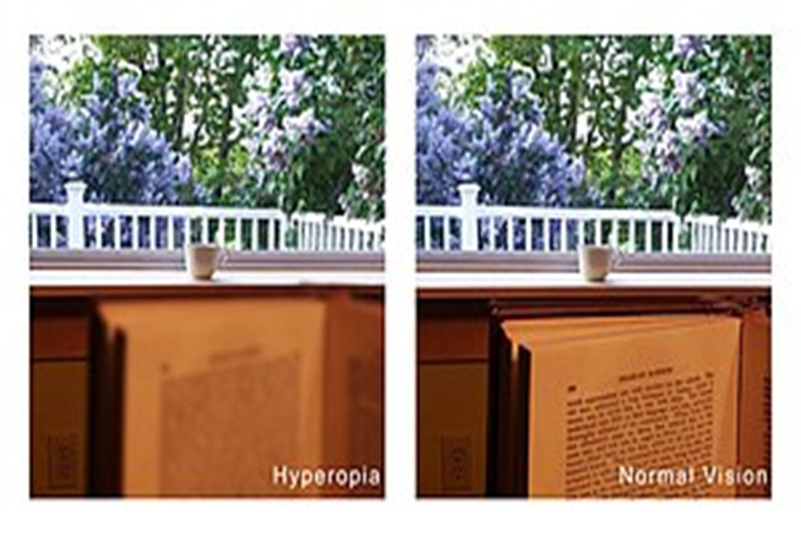
Hypermetropia or long-sight
Occurs when an eye cannot focus on nearby objects.
The uncorrected near point of the defective eye is further away than 25 cm.

Slide 4
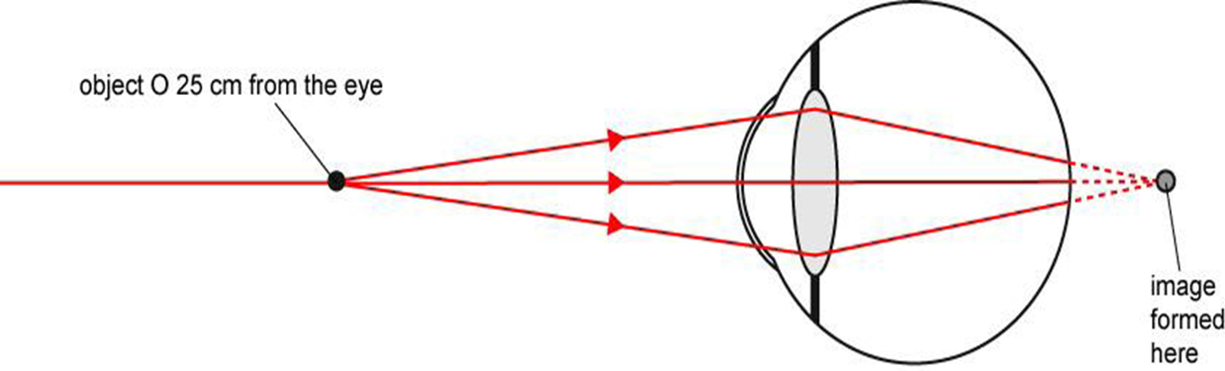
This is because
The eye muscles cannot make the eye lens thick enough to focus an image on the retina of an object 25 cm away.
It is focus an image behind the retina.
The eye can focus distant objects hence the defect is referred to as ‘long-sight’.

Slide 5
The cause of hypermetropia is that:
The eye lens cannot become thick enough to focus light onto the retina or
If the eyeball is too short.
light, after passing through the eye lens, does not converge enough to form an image on the retina,
Correct hypermetropia
To correct hypermetropia using a lens, a converging(convex) lens of a suitable focal length must be placed in front of the eye.
The correcting lens makes the rays from an object 25 cm away diverge less so they appear to come from the uncorrected near point.

Slide 6
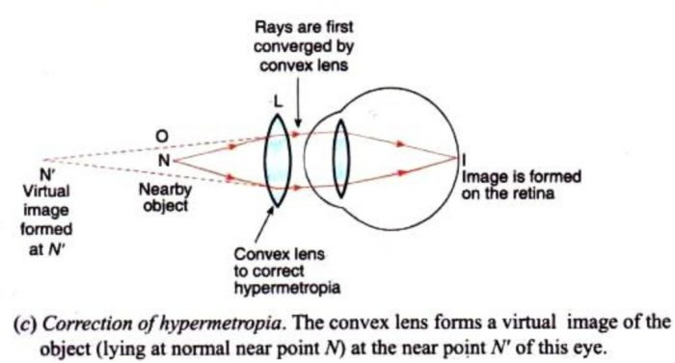
Therefore, the correcting lens for hypermetropia must:
Converging lens have a focal length which makes an object placed 25 cm from the eye appear as if it is at the uncorrected near point.
The correcting lens forms a virtual image of the point object at the uncorrected near point
The cornea and eye lens see the object as if it was at the uncorrected near point and form a real image of the object on the retina.

Slide 7
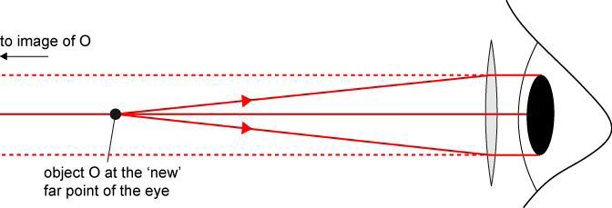
Note
The correcting lens effectively moves the near point of the uncorrected eye nearer the lens to 25 cm away (the near point of a normal eye).
It also ‘moves’ the far point from infinity nearer to the eye.
The correcting lens makes the image of an object at the ‘new’ far point appear to be at infinity.

Slide 8
Effect on the far point
The object must be at the focal point of the converging lens for the rays to become parallel after the lens to make the image appear to be at infinity.
Therefore, the new far point is at distance f from the lens, where f is the focal length of the lens.

Slide 9
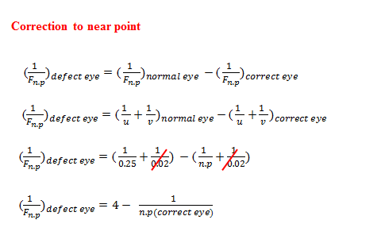

Slide 10
Example
A long-sighted eye has the far point at infinity and a near point which is 40 cm from the eye.
a. State the type of lens needed to correct this defect and calculate the power of the correcting lens.
b. Calculate the distance from the lens to the far point of the eye with the correcting lens in front of the eye.

Slide 11
Solution
a -A converging lens is needed.
For an object at 25 cm from the eye, the object distance
u = +25 cm = +0.25 m
The lens must form a virtual image of the object at the uncorrected near point of the eye.
Hence the image distance v = −40 cm
Using 1/f= 1/u + 1/v
with u= + 0.25 m and v = −0.40 m gives
1/f= 1/(0.25) +1/(-0.4) = 4 -2.5 = +1.5 D

Slide 12
b .The distance from the lens to the ‘new’ far point = f = 1/1.5= 0.67 m
The new far point is at distance f from the lens, where f is the focal length of the lens.

Slide 13
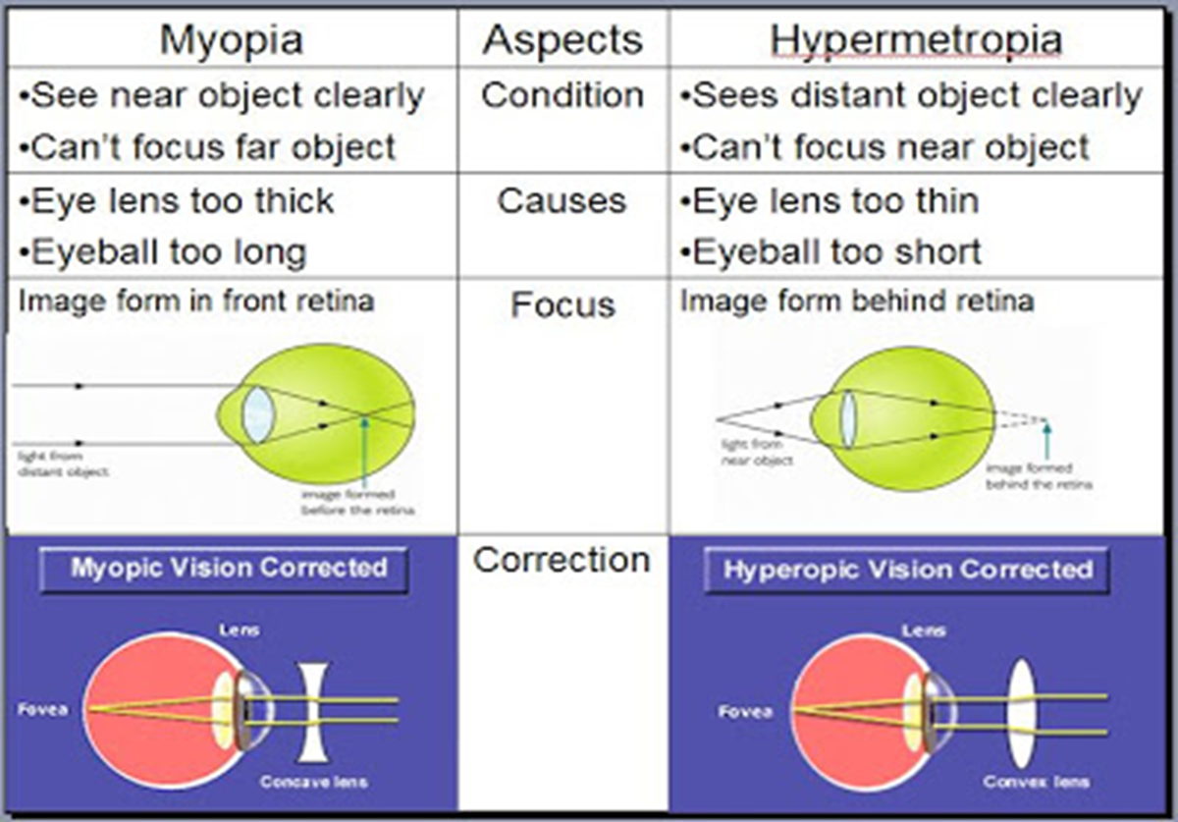

Slide 14
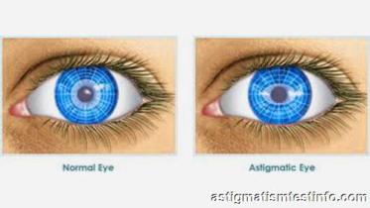
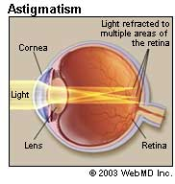
Astigmatism and its correction:
In Astigmatism the parallel beam of light rays incident on the cornea after refraction are not focused to form a point image near or on the retina.
Astigmatism :Occurs when the cornea does not have a spherical shape.

Slide 15
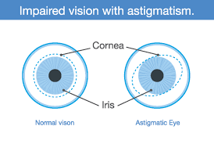
What causes astigmatism?
Astigmatism occurs when the front surface of the eye (the cornea) or the lens inside the eye is more oval or cylindrical than round.
Astigmatism is caused by small differences in the growth and alignment of the components of the eye.
Genetics may play a role in the development of refractive error.
Astigmatism may also result from such factors as pressure of the eyelids on the cornea.

Slide 16
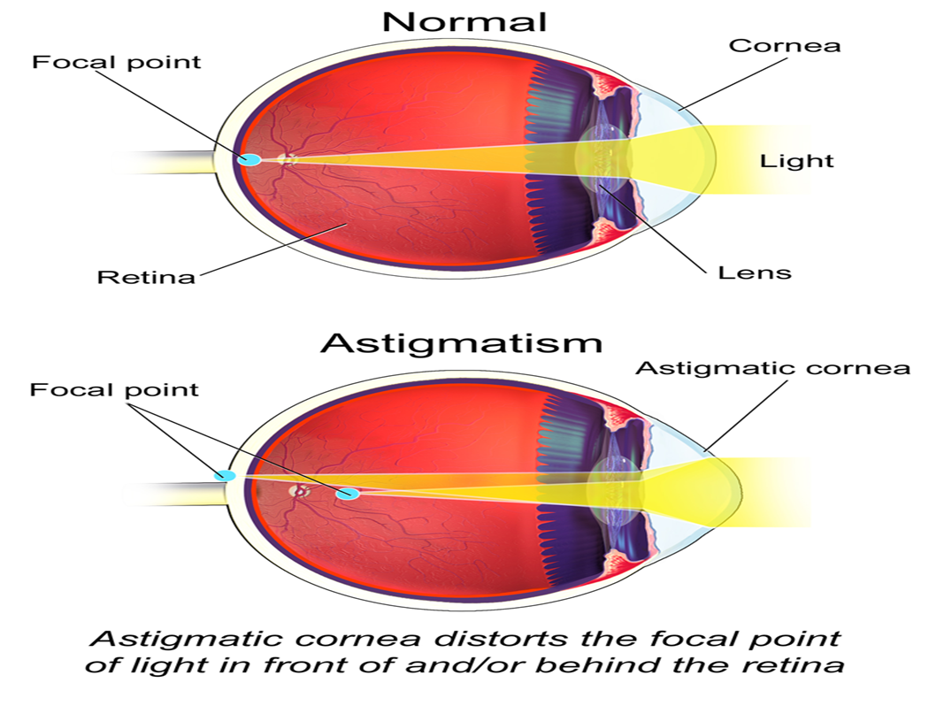
The result of the different curvatures is that the eye has more than one place where the image focuses. When astigmatism is present, point objects do not form point images on the retina.

Slide 17
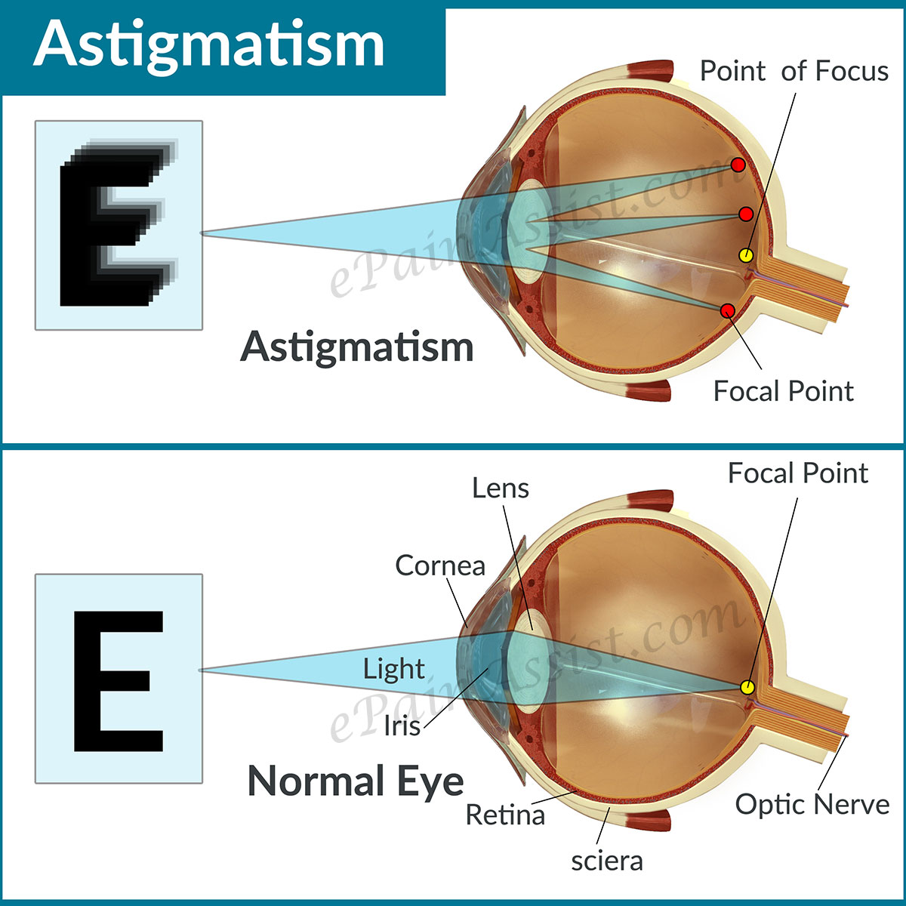
What are the types of astigmatism?
The two main types of astigmatism are corneal and lenticular.
A corneal astigmatism happens when your cornea is misshapen.
A lenticular astigmatism happens when your lens is misshapen.

Slide 18
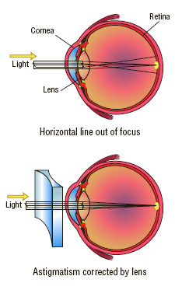
The correction of astigmatism:
Eyeglasses , contact lenses , refractive surgery.
Astigmatism requires a lens with a cylindrical-shaped surface orientated so that it compensates for the uneven curvature of the cornea.

Slide 19
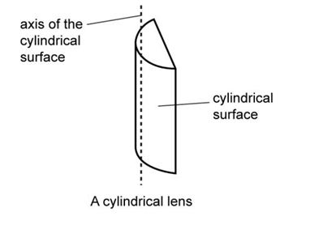
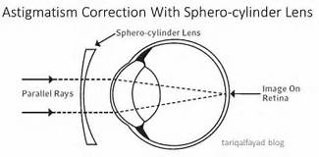
An optician’s prescription for astigmatism will state:
The curvature of the cylindrical-shaped surface
The orientation of the axis of the cylindrical surface.

Slide 20
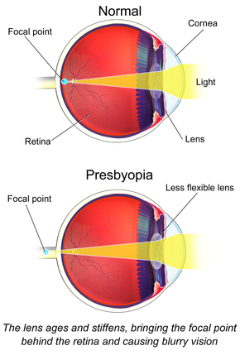
Presbyopia:
This is due to the Lens inside the eye losing its elasticity, thus becoming unable to focus when things are at a close range.

Slide 21
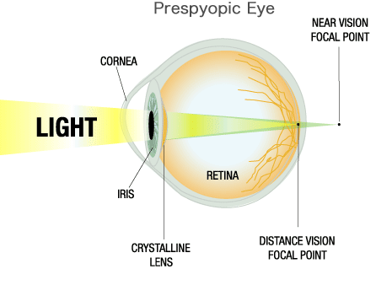
Presbyopia is often confused with farsightedness, but the two are different:
Presbyopia happens when the natural lens in the eye gets less flexible.
Farsightedness is from a misshaped eyeball that causes light rays to focus incorrectly once they have entered the eye

Slide 22
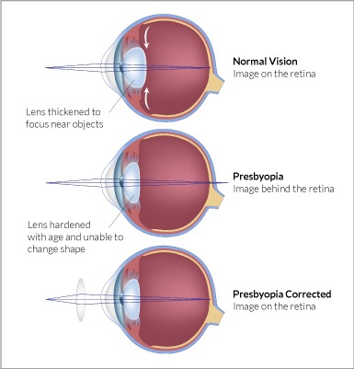
The cillary muscles weaken and lens losses some of its elasticity.

Slide 23
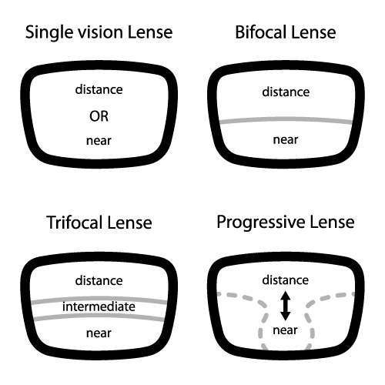
The correction of Presbyopia
( Bifocal lenses)
upper half of each lens is diverging and corrects the myopia when the wears is looking ahead at distance objects,
The lower half corrects the presbyopia with a suitable converging lens, and the wearer looks through this part when reading.

Slide 24


